Slide 1

CIS – 731 Final Project
Automatic music generation using a combination of neural network architectures
1 group member (Aneesh Phatak)

Slide 2
Overview
Basic idea is to use famous compositions by some of the greatest composers in the world and create a brand-new sequence of music
Our NN should remember patterns from hundreds of compositions and generate original music
I used only single-instrument(piano) as the basis for new music but multi-instrument music generation(similar to an orchestra) can be achieved by complex methods
In the near future, musicians could use AI-based algorithms to develop brilliant music

Slide 3
Dataset
Used piano-based compositions by stellar composers such as Bach, Mozart etc. as input dataset
File format was MIDI(Musical Instrument Digital Interface File)
These contain the instructions rather than the actual audio. Hence, it occupies very little memory. That’s why it is usually preferred while processing music data.
Using the python library music21, I obtained a list of all the notes and chords in each file.
Sequences that will be used as input to NN were created

Slide 4
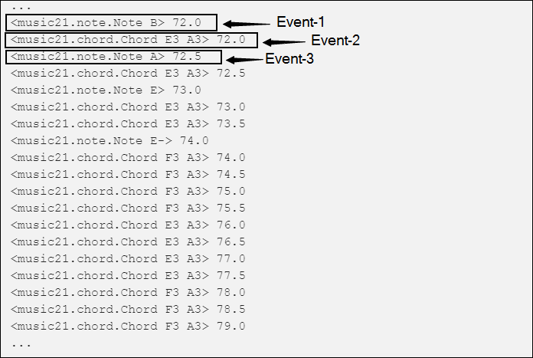

Slide 5
Approach
Load the MIDI files into our environment
Extract the number of unique tones and their distribution
Set a frequency threshold for the notes to drop unimportant notes
Create input sequence for NN by reshaping it
Modify model architecture to meet our needs
Create output sequence in a playable format.

Slide 6
Create output sequence
Output was put together using a rolling-window approach
Say you have a sequence of 10 notes as input and you generate the 11th note based on this input
These 11 notes will then be fed to the network to generate 12th note
This process is recursively continued unitil you get a sequence of notes with desired length.

Slide 7
NN architecture
Humans dont start thinking from scratch every second, they evaluate their position in real time based on their understanding of previous experiences.
The output of every input chunk of music depends only on the past information ( i.e. previous timesteps) but not on the future timesteps. Hence, this task is known as Autoregressive task and the model is known as an Autoregressive model
Used a combination of Wavenet, LSTM and GRU layers
LSTM performed the best in terms of passability of generated music
Wavenet would perhaps be more useful to mimic human voice lyrics if such models are perfected

Slide 8
LSTM
Long Short Term Memory networks — usually just called “LSTMs” — are a special kind of RNN, capable of learning long-term dependencies.
A model architechture consists of numerous layers in its flow, and each layer consists of numerous LSTM units,
For our best model, we have used 256 LSTM Units in each layer. The last layer used is a Softmax Layer.
Dropout is kept as 0.2. It is generally a good advice to start from around 0.5 and keep on decreasing until you get decent results. Also, it is a good practice to keep changing the weights of the model, and see the insights it gives us and changes it produces.

Slide 9
Evaluation
A subjective evaluation was done by opinions of 5 volunteers who evaluated the music generated from different models.
The volunteers were folks with classical music interest and/or who had been amateur performers or composers.
Each volunteer was given a short explanation of how music is generated and the chance to tweak model hyperparameters.
The music style was piano-based, with tempo four notes per beats. Each volunteer listened to 16 pieces of music whose arrangement had been randomized.
In conclusion, a LSTM-based model was unanimously chosen as the go-to architecture for our purpose.

Slide 10
Future scope of AI-based music generation
In September 2018, Taryn Southern became the first artist to compose and produce an album entirely using Artificial Intelligence.
Southern says, "In the near future, I'm pretty certain we'll see artists soon using machine learning for a plethora of music applications - to mix and master their songs, help them identify unique chord progressions, alter instrumentation to change style, and determine more interesting melody structures."
The artist named 'The Most Famous Artist' partnered with hackers to create AI capable of emulating renowned art styles to create high-end originals.
There's already a lot of movement and investment underway.
IBM, Spotify and Google are all working on AI software to help create music.
For platforms like Spotify, AI already drives key features like their recommendation engines.

